Slide 1
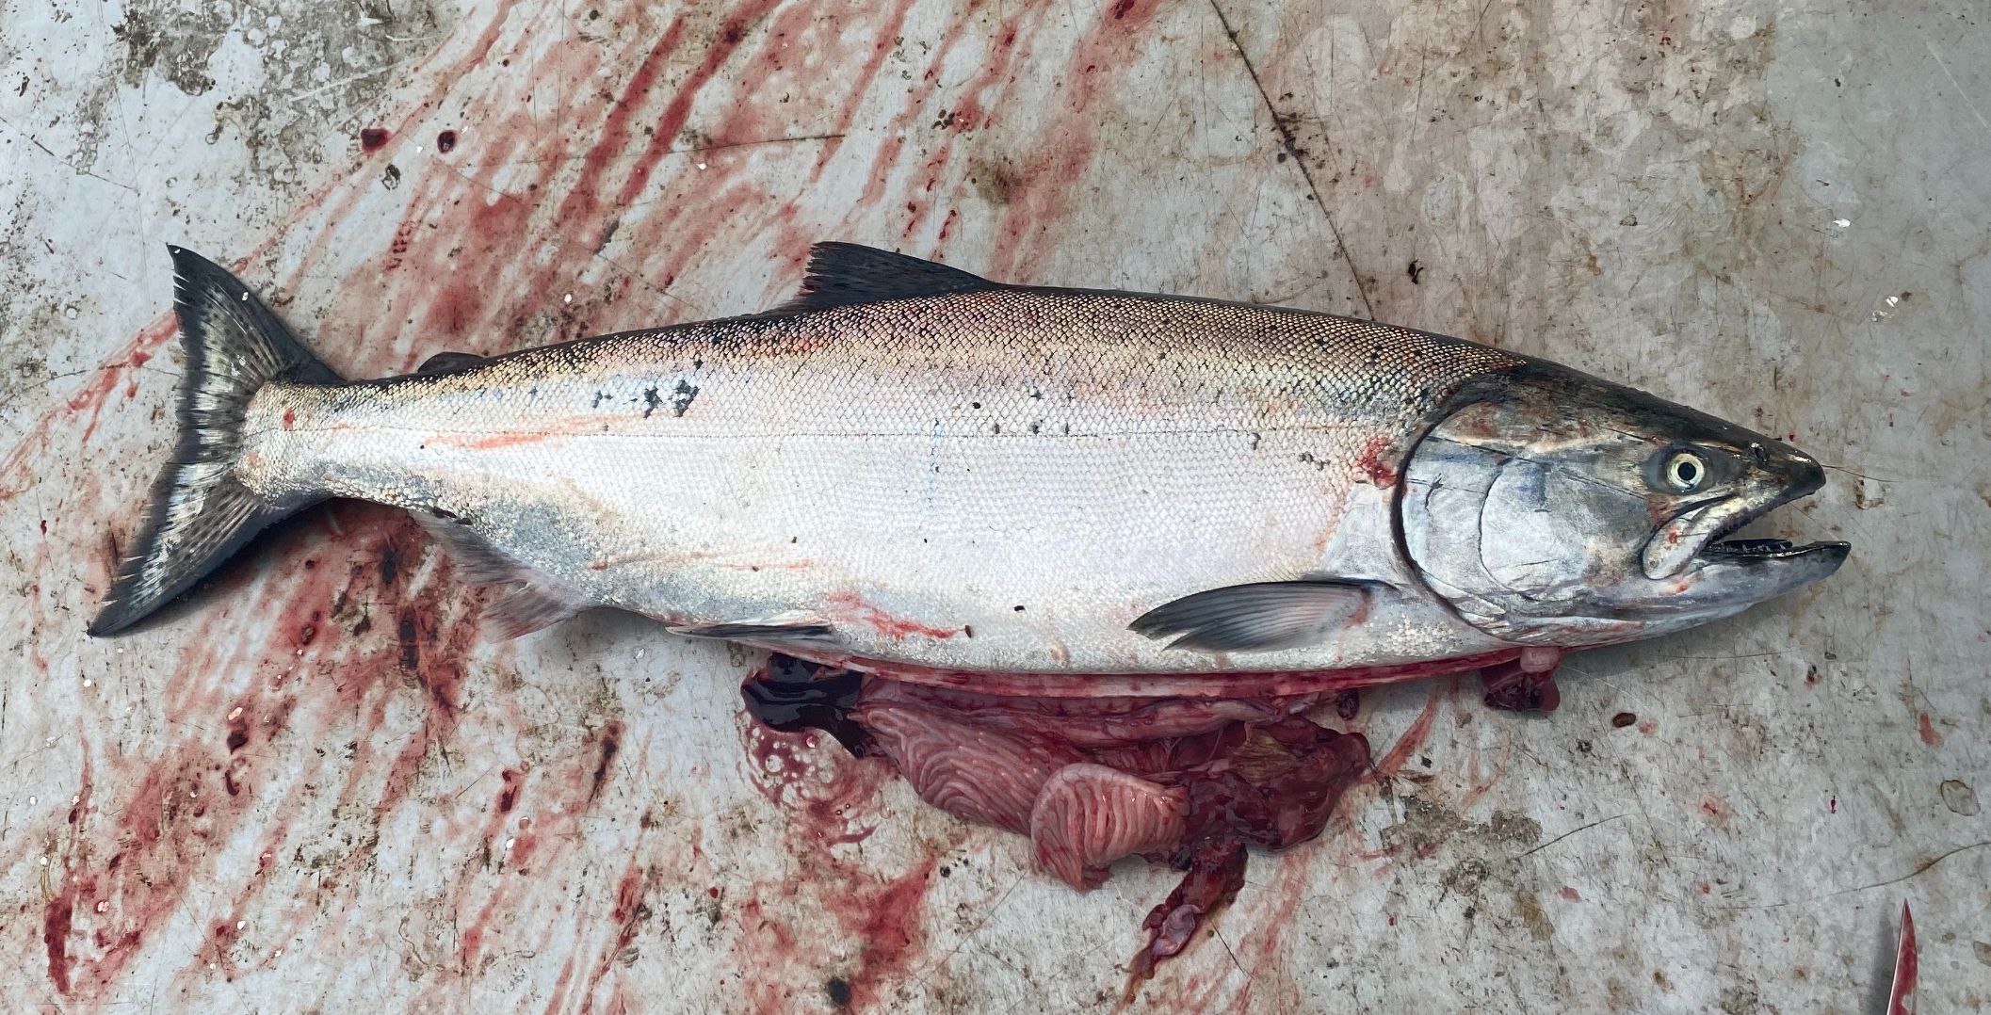


Adult Salmon Diet Program
ES 482/582 Data Project By Rebecca Hansen and Jessica Qualley April 3, 2020
Notes:
First, we would like to acknowledge Will Duguid, Katie Innes, Micah Qunidazzi, Nick Bohlender, and Francis Juanes for spearheading and supporting the Adult Salmon Diet Program.
The adult Chinook and Coho Salmon Diet Program (Juanes Lab) seeks to address basic knowledge gaps in our understanding of what salmon eat in this region by sourcing stomach samples collected by the recreational fishing community.
The goal is to gather regional, seasonal and interannual diet data to monitor ecosystem response to environmental change.

Slide 2
Introduction
Research question
Hypotheses
Notes:
Pacific Herring have been found to be the dominant fish consumed by Chinook Salmon throughout regions of the Salish Sea, throughout the year.
For this project we will investigate factors that may be important to the size of herring consumed by Chinook Salmon.
We want to know how Chinook size, catch location and time of year in the Salish Sea affect the size of herring prey consumed by Chinook salmon.
We hypothesize that herring size will be positively linear with salmon length, collection day of year and latitude. However, a negative linear relationship with longitude may occur because more herring are known to distribute along western Strait of Georgia. Alternatively, a non-linear relationship with longitude is possible if maximum herring size occurs in mid-channel waters.

Slide 3
Description of Data
Data collection
Response variable
Explanatory variables
Notes:
We will be assessing the relationship between herring size consumed by Chinook Salmon in the Salish Sea over the 2018 year.
The size of herring is estimated using otolith width (mm) measurements. Otoliths are paired aragonitic structures that grow inside the cranium of most teleost fishes like the rings of a tree. They are commonly used by fisheries scientists to assess growth trajectories, age and even migration patterns of individual fish. Previous work in our lab has found a positive, linear relationship between otolith width (mm) and length (mm) of herring from this dataset, and therefore we will use averaged left and right otolith width (mm) measurements from individual herring as a proxy for herring size in this analysis.
We will model the response of otolith width to associated salmon catch data recorded by each angler and linked to each stomach sample. These variables include salmon catch day in the 2018 year, salmon length, longitude and latitude.
We will only look at Chinook Salmon collected in the Canadian Salish Sea during the 2018 year.

Slide 4
Statistical Methods
What kind of model
Why
Probability distribution for response
Random effects and non-independence
Notes:
We used AIC to compare candidate linear mixed-effects models fit with maximum likelihood estimation.
We included a random intercept corresponding to individual salmon (salmon id) to avoid autocorrelation from non-independence of multiple herring that may occur in a single salmon or experimental unit. It is likely that multiple herring in one stomach have similar sizes if they travel in the same school targeted by an individual salmon. Also, salmon id had greater than 10 levels suggested by Zuur et al. (2007) to be suitable characteristics of a random intercept.
We used a linear mixed-effects model as our response variable, otolith width (mm), was normally distributed and explanatory variables show few missing values or outliers.
We chose AIC because it is flexible when comparing complex, non-nested models with parameters estimated from ecological field studies. AIC is also commonly used in ecosystem studies where parameter estimates are relatively imprecise. We accept that the optimal AIC model may be selected over the true model, given the current sample size and our ecological understanding of the system.

Slide 5
Results
Plot “response relative to explanatory with model”

Slide 6
Results
In the context of results and hypotheses

Slide 7
Discussion
Limitations to data analysis approach

Slide 8
Discussion
Results in context of existing knowledge
Future research questions

Slide 9
Checklist
PDF file
10 slides max
2 slides of plots min
Complete sentences

